Slide 1
Viking invasion
On the Anglo-Saxons kingdoms

Slide 2
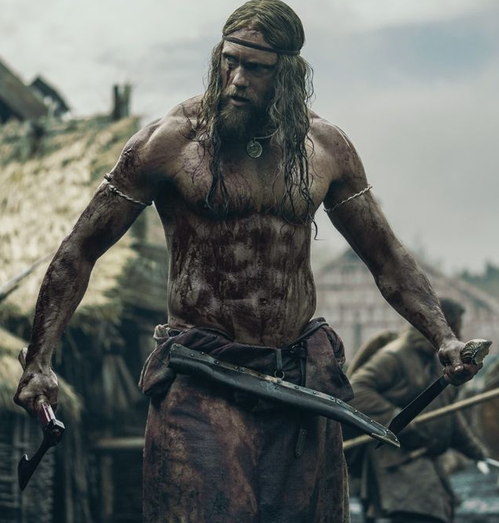
Summary
Brief introduction to the world of vikings
Vikings invasion on England
Vikings first raids
The Danelaw
The battle of Tettenhall
Vikings and the pop culture
Viking culture

Slide 3
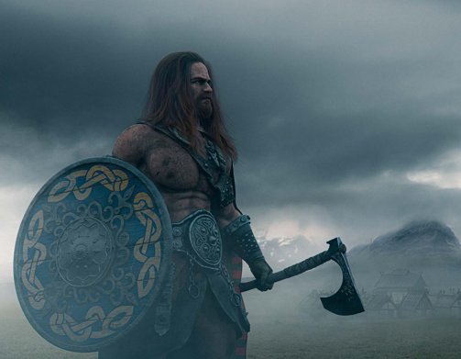
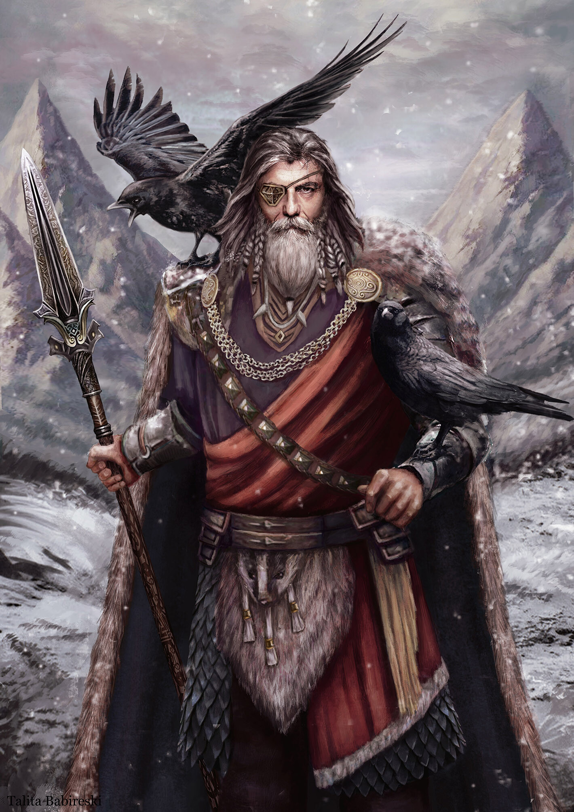
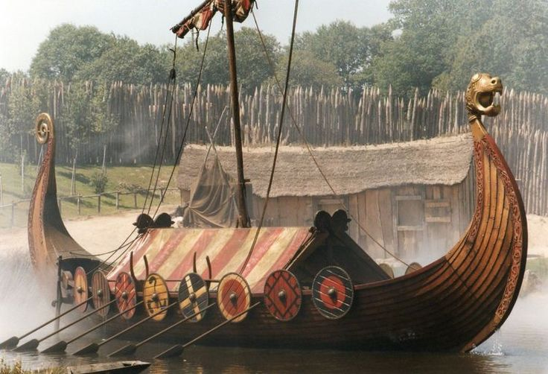
Who were the vikings?
Viking
Odin
A longship

Slide 4
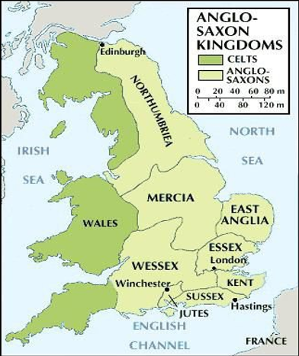
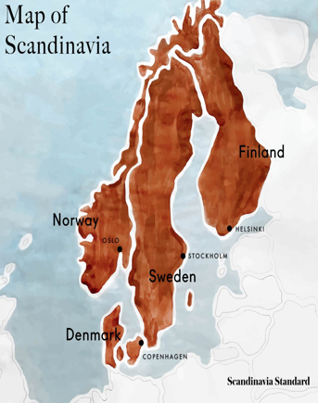
Saxons/Celts kingdoms
Scandinavia of 8th century

Slide 5

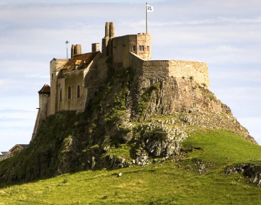
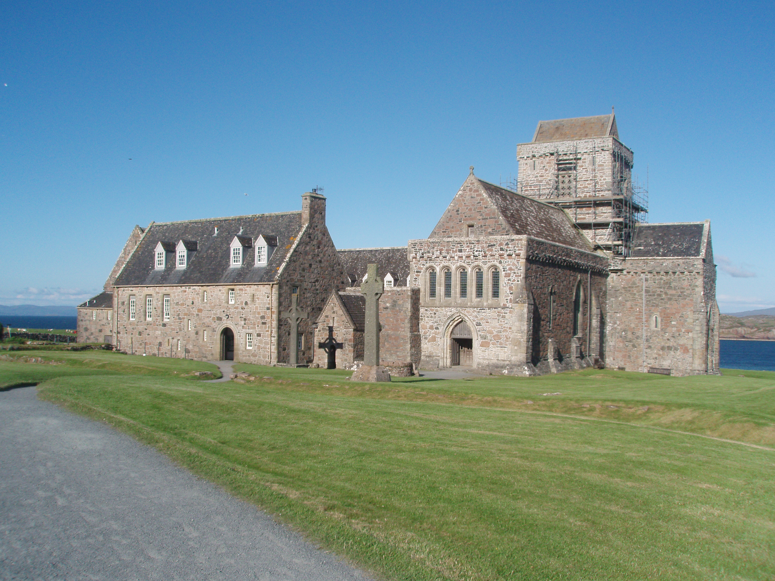
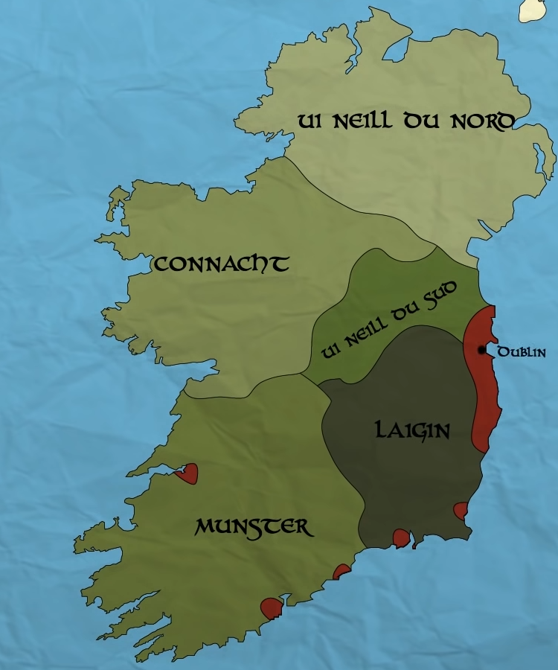
Vikings first raids :
Danes :
Year 793
Limdisfarne
Norvegians :
Year 795
Iona
~ year 850, Scotland

Slide 6
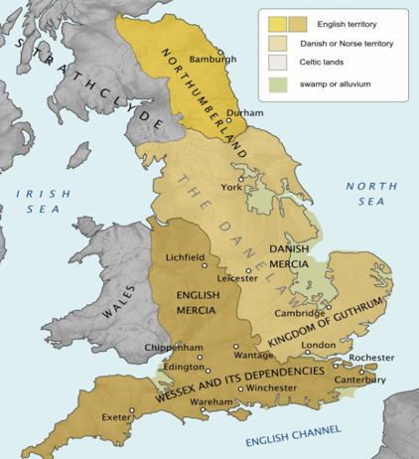

The Great heathen army and the Danelaw
865 : East-Anglia attacked by Ragnar sons :
Ivar , Halfdan and Ubba
~ 877 : Kingdom of York
- 886 : Creation of the Danelaw

Slide 7
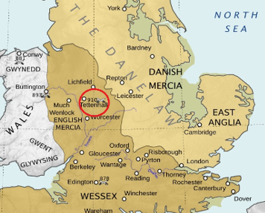




The end of Vikings : The battle of Tettenhal
Mercia & Wessex VS Northumbrian Vikings
Death of Eowils, Halfdan and Ingwaer
End of Viking expansion
~ 954 : End of Viking Era

Slide 8



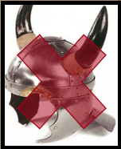
Vikings and the pop culture :

Slide 9


To sum up :
793
866
910
~954
First viking raid
Creation of the Danelaw
Battle of Tettenhall
End of Viking Era

Slide 10
The END

